Slide 1
Integration Overview
For Patient Appointment Reminders
© Copyright 2017. Integration Ver. 1 (www.notifyglobal.com)
NotifyGlobal, 1230 Hwy 34, Aberdeen, NJ 07747, USA. 1-212-918-2900

Slide 2
WHAT IS INTEGRATION?
Some clients use NotifyGlobal’s web interface directly to manage reminders & broadcasts.
However, many clients require a more seamless way of using NotifyGlobal through their existing EHR/EMR portals. This bridge between the EHR/EMR portal and NotifyGlobal is called integration. Integration allows the two independent applications to communicate.

Slide 3
Integration Options
HL7 Formatted File
SOAP API (Client to Server)
Custom Flat File (CSV, TXT)
Custom API (Server to Client)
3

Slide 4
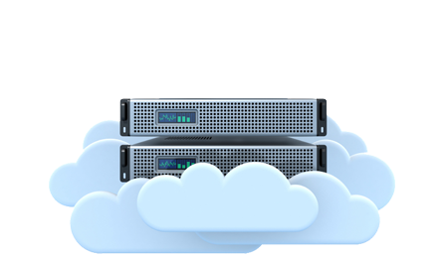
Integration: HL7 Formatted File
Step 2: Office Admin uploads the file to the NotifyGlobal system in the cloud or on premise
Step 3: At the right date/time, NotifyGlobal sends reminder messages to patients via phone, SMS and email.
Step 1: Office Admin exports HL7 files with appointments from EMR/EHR system
Step 4: Patient responds with confirmation or cancellation
Step 5: NotifyGlobal sends an appointment confirmation report to office admin and an HL7 response file to EHR/EMR system.
Example:
MSH|^~\&|GPMS|CTX||MED2000|200803060953||SIU^S14|20080306953450|P|2.3|||||||| SCH|00331839401|||||58||HLCK^HEALTHCHECK ANY AGE|20|MIN|^^^200803061000 |||||JOHN||||VALERIE|||||ARRIVED| PID|1||489671|0|SMITH^MICHAEL^||20080205|F|||176215TH STREET^HOUSTON^TX^77306||(832)735-8259|||S|||999999999|||||||||||| PV1|1|O|||||HHR^NGUYENSUSAN MD|^||||||||||||||||||||||||||||||||||| |||||||||| RGS|1||| AIL|1||HHR^FPCS NGUYEN, MD|||||||||| NTE|1||1MONTH HLCK^^| AIP|1||PBN^LISAPORTER|50|||||||||
HL7 is an international standard file format for transferring health data
NotifyGlobal supports HL7 SIU for Appointment Reminders
Many EHR/EMR packages support HL7 SIU exports and imports

Slide 5
Integration: CSV/TXT Flat File
Step 2: Office Admin uploads the file to the NotifyGlobal system in the cloud or on premise
Step 3: At the right date/time, NotifyGlobal sends reminder messages to patients via phone, SMS and email.
Step 1: Office Admin exports custom format with appointments from EMR/EHR system
Step 4: Patient responds with confirmation or cancellation
Step 5: NotifyGlobal sends an appointment confirmation report to office admin and a response file to EHR/EMR system.
Example:
Doe,Jane,12135551212,jane.doe@gmail.com,Well Visit,12135551212,2017-12-20 09:00
Hanes,John,15125551212,jane.doe@gmail.com,New Patient,15125551212,2017-12-20 13:30
NotifyGlobal will import your custom appointment file format
Most EHR/EMR packages support flat file exports
Most EHR/EMRs can automatically upload files to NotifyGlobal
EPIC uses this option of Integration

Slide 6
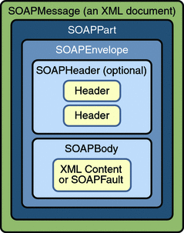
Integration: XML/SOAP API
EMR/EHR Application
SOAP is a messaging protocol that allows your EMR to communicate with NotifyGlobal
SOAP messages are sent via TCP/IP across a local or public network
NotifyGlobal has a prebuilt SOAP API that allows EMRs to send & get specific information
Allows for seamless, real-time integration with your EMR application
EMR can pull or push data at any time
This can be used for appointment reminders, broadcasts, and more
This is the most involved integration option to use, but offers the most flexibility

Slide 7
Integration: Custom API (Server to Client)
EMR/EHR Application
EMR/EHR Defined (Custom API)
NotifyGlobal can integrate with any EMR/EHR’s proprietary API
Custom API messages are sent via TCP/IP across a local or public network
Allows for seamless, real-time integration with your EMR application
Functionality will vary on a case by case basis
This requires NotifyGlobal to develop custom code
This is the least frequently used integration option

